Slide 1
Java Control Statements

Slide 2
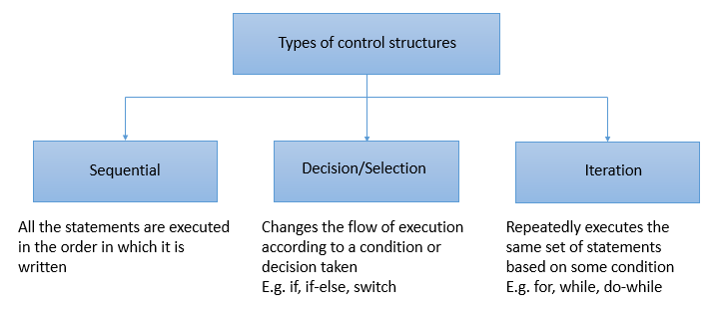
Introduction

Slide 3
If statement
"if" statement is used to evaluate a condition. The control of the program is diverted depending upon the specific condition. The condition of the If statement gives a Boolean value, either true or false. In Java, there are four types of if-statements
if(condition) {
statement 1; //executes when condition is true
}

Slide 4
If else
The if-else statement is an extension to the if-statement, which uses another block of code, i.e., else block. The else block is executed if the condition of the if-block is evaluated as false.
if(condition) {
statement 1; //executes when condition is true
}
else{
statement 2; //executes when condition is false
}

Slide 5
If else If
if-else-if statement contains the if-statement followed by multiple else-if statements. In other words, we can say that it is the chain of if-else statements that create a decision tree where the program may enter in the block of code where the condition is true. We can also define an else statement at the end of the chain.
if(condition 1) {
statement 1; //executes when condition 1 is true
}
else if(condition 2) {
statement 2; //executes when condition 2 is true
}
else {
statement 2; //executes when all the conditions are false
}

Slide 6
Nested if-statement
In nested if-statements, the if statement can contain a if or if-else statement inside another if or else-if statement.
if(condition 1) {
statement 1; //executes when condition 1 is true
if(condition 2) {
statement 2; //executes when condition 2 is true
}
else{
statement 2; //executes when condition 2 is false
}
}

Slide 7
Switch Statement:
In Java, Switch statements are similar to if-else-if statements. The switch statement contains multiple blocks of code called cases and a single case is executed based on the variable which is being switched. The switch statement is easier to use instead of if-else-if statements. It also enhances the readability of the program.

Slide 8
Switch
switch (expression){
case value1:
statement1;
break;
.
.
.
case valueN:
statementN;
break;
default:
default statement;
}

Slide 9
Switch
The case variables can be int, short, byte, char, or enumeration. String type is also supported since version 7 of Java
Cases cannot be duplicate
Default statement is executed when any of the case doesn't match the value of expression. It is optional.
Break statement terminates the switch block when the condition is satisfied. It is optional, if not used, next case is executed.
While using switch statements, we must notice that the case expression will be of the same type as the variable. However, it will also be a constant value.

Slide 10
Loop Statements
In programming, sometimes we need to execute the block of code repeatedly while some condition evaluates to true. However, loop statements are used to execute the set of instructions in a repeated order. The execution of the set of instructions depends upon a particular condition.
for loop
while loop
do-while loop

Slide 11
Java While Loop
The Java while loop is used to iterate a part of the program
repeatedly until the specified Boolean condition is true. As soon as the Boolean condition becomes false, the loop automatically stops.
while (condition){
//code to be executed
I ncrement / decrement statement
}

Slide 12
do-while loop
The Java do-while loop is used to iterate a part of the program repeatedly, until the specified condition is true. If the number of iteration is not fixed and you must have to execute the loop at least once, it is recommended to use a do-while loop.
Java do-while loop is called an exit control loop. Therefore, unlike while loop and for loop, the do-while check the condition at the end of loop body. The Java do-while loop is executed at least once because condition is checked after loop body.
do{
//code to be executed / loop body
//update statement
}while (condition);

Slide 13
Java for loop
In Java, for loop is similar to C and C++. It enables us to initialize the loop variable, check the condition, and increment/decrement in a single line of code. We use the for loop only when we exactly know the number of times, we want to execute the block of code.
for(initialization, condition, increment/decrement) {
//block of statements
}

Slide 14
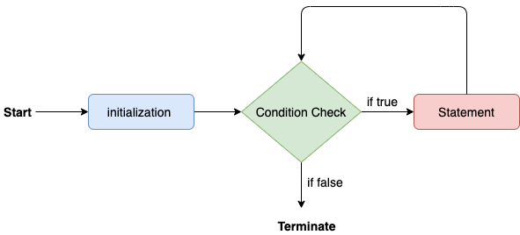
Java for loop

Slide 15
Break statement
When a break statement is encountered inside a loop, the loop is immediately terminated and the program control resumes at the next statement following the loop.
The Java break statement is used to break loop or switch
statement. It breaks the current flow of the program at specified condition. In case of inner loop, it breaks only inner loop.
We can use Java break statement in all types of loops such as for loop
, while loop
and do-while loop

Slide 16
Java Continue Statement
The continue statement is used in loop control structure when you need to jump to the next iteration of the loop immediately. It can be used with for loop or while loop.

